Slide 1
Binary Search Trees
Contents:
What is a binary search tree?
Querying a binary search tree
Insertion and deletion
Randomly built binary search trees (*)

Slide 2
Search Trees
Data structures that support many dynamic-set operations
SEARCH, MINIMUM, MAXIMUM, PREDECESSOR, SUCCESSOR, INSERT, DELETE
Can be used as both a dictionary and as a priority queue
Basic operations take time proportional to the height of the tree
For complete binary tree with n nodes: worst case
For linear chain of n nodes: worst case
Different types of search trees include binary search trees, red-black trees (Ch13), and B-trees (Ch18)
We will cover binary search trees, tree walks, and operations on binary search trees

Slide 3
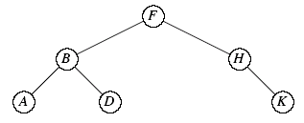
Binary Search Trees
Important data structure for dynamic sets
Accomplish many dynamic-set operation in O(h) time
Use a linked data structure to represent a binary tree
Node : object contains key, left, right, p
root[T] : root of tree T, p[root[T]]=NIL
Binary-search-tree property
If y is in left subtree of x, then key[y] ≤ key[x]
If y is in right subtree of x, then key[y] ≥ key[x]
Height of a tree
5
3
7
2
5
8

Slide 4
Inorder-Tree-Walk
Print keys in a binary search tree in order, recursively
Check to make sure that x is not NIL
Recursively, print the keys of the nodes in x’s left subtree
Print x’s key
Recursively, print the keys of the nodes in x’s right subtree
INORDER-TREE-WALK(x)
if x ≠ NIL
then INORDER-TREE-WALK(left[x])
print key[x]
INORDER-TREE-WALK(right[x])
e.g. ABDFHK
Correctness: by induction directly from the binary-search-tree property
Time: O(n) time for a tree with n nodes, because we visit and print each node once. To show T(n)≤(c+d) n +c, Let T(0)=c,T(n) ≤T(k)+T(n - k -1)+d, then T(k) ≤ (c+d)k +c and T(n - k -1) ≤ (c+d)(n - k -1 ) +c= (c+d)(n - k)-d. Thus T(n) ≤ (c+d)n +c-d ≤ (c+d)n +c
Notes:
To show T(n)≤(c+d)n+c by substitution,
For n=0, it is easy to know T(0) is a constant, let it be c
For n>0, we know T(n) ≤T(k)+T(n-k-1)+d for sure, plug-in T(k) ≤(c+d)k+c and T(n-k-1) ≤(c+d)(n-k-1)+c by induction assumption (i.e. true for input numbers k or n-k-1 that are both < n)
Then we will get T(n) ≤(c+d)n+c

Slide 5
Searching a Binary Search Tree
Search for the element with key=k, TREE-SEARCH(root [T], k)
Time: The algorithm recurs, visiting nodes on a downward path from the root. Thus, running time is O(h)
TREE-SEARCH(x, k)
if x = NIL or k = key[x]
then return x
if k < key[x]
then return TREE-SEARCH(left[x], k)
else return TREE-SEARCH(right[x], k)
e.g. search for D

Slide 6
Minimum and Maximum
The binary-search-tree property guarantees that
The minimum (maximum) key of a binary search tree is located at the leftmost (rightmost) node
Traverse the appropriate pointers (left or right) until NIL is reached.
Time: Both procedures visit nodes that form a downward path from the root to a leaf.
Both procedures run in O(h) time
TREE-MINIMUM(x)
while left[x] ≠ NIL
do x ← left[x]
return x
TREE-MAXIMUM(x)
while right[x] ≠ NIL
do x ← right[x]
return x

Slide 7
Successor and Predecessor
Assuming that all keys are distinct,
y = successor[x] ➔ key[y] is the smallest key > key[x]
y = predecessor[x] ➔ key[y] is the largest key < key[x]
We can find x’s successor based entirely on the tree structure. No key comparisons are necessary
If x has the largest key in the binary search tree, then we say that x’s successor is NIL
To identify y, the successor of x, there are two cases:
If node x has a non-empty right subtree, then y is the minimum in x’s right subtree (i.e., the leftmost node in the right subtree)
If node x has an empty right subtree,
x must NOT be in y’s right subtree, and be the maximum in y’s left subtree
y is the lowest ancestor of x whose left child is also an ancestor of x
i.e., if we move up from x, y is the first ancestor we encounter when we go right

Slide 8
Searching for Successor
y = successor[x]
Key points: y > x
y is in x’s right subtree (y₁: the minimum in x’s right subtree)
x is in y’s left subtree (y₂ : the lowest such ancestor)
y₁ < y₂ ➔ first check the existence of y₁, then y₂
y = predecessor[x]
Key points: y < x
y is in x’s left subtree (y₁: the maximum in x’s left subtree)
x is in y’s right subtree (y₂ : the maximum in x’s ancestors)
y₁ < y₂ ➔ first check the existence of y₁, then y₂
y
y
x
y
y
y
x
y

Slide 9
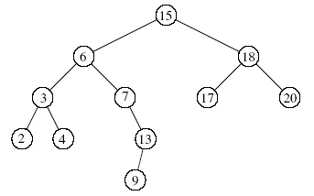
Searching for Successor
Q: the successor of the node with key value 15,6,4,17=?
Q: the predecessor of the node with key value 15,6,4,17=?
TREE-PREDECESSOR is symmetric to TREE-SUCCESSOR
i.e., change right[x] by left[x] & TREE-MAXIMUM by TREE-MINIMUM
Time: O(h)
TREE-SUCCESSOR(x)
if right[x] ≠ NIL
then return TREE-MINIMUM(right[x])
y ← p[x]
while y ≠ NIL and x = right[y]
do x ← y
y ← p[y]
return y
A: 17,7,6,18
A: 13,4,3,15
y
y
y
y
y = successor[x]
x
y = predessor[x]
x
y
y

Slide 10
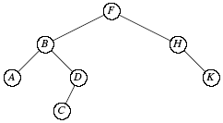
Insertion
To insert z with key[z] = v, left[z] = NIL, and right[z] = NIL
Idea: for a node x, compare key[z] and key[x]
set y = p[x],
If key[z] < key[x], z should be in x’s left subtree
else z is in x’s right subtree
Diving: Record y = x, dive on the left (or right) subtree of x by x = left[x] (or x = right[x]) , thus y = p[x]
As long as x ≠ NIL, we keep diving as above
Then compare key[z] and key[y]
If key[z] < key[y], then left[y] = z
else right[y] = z
Time: O(h)
TREE-INSERT(T, z)
y ← NIL
x ← root[T ]
while x ≠ NIL
do y ← x
if key[z] < key[x]
then x ← left[x]
else x ← right[x]
p[z] ← y
if y = NIL // T was empty
then root[T ] ← z
else if key[z] < key[y]
then left[y] ← z
else right[y]← z
e.g., INSERT C

Slide 11

Deletion
from Edition 2
TREE-DELETE(T,z) deletes node z from T
Case 1: z has no children
Delete z by making the parent of z point to NIL, instead of to z
Case 2: z has one child
Delete z by making the parent of z point to z’s child, instead of to z
Case 3: z has two children
y = successor[z] must be in z’s right subree, and have either no children or one child. (y is the minimum node—with no left child—in z’s right subtree.)
Delete y from the tree (via Case 1 or 2).
Replace z’s key and satellite data with y’s.
e.g., Case 1: delete K Case 2: delete H Case 3: delete B, swap it with C

Slide 12
from Edition 2
TREE-DELETE(T, z)
//Determine which node y to splice out: either z or z’s successor.
if left[z] = NIL or right[z] = NIL //z has one or zero child
then y ← z
else y ← TREE-SUCCESSOR(z) //z has two children
// x is set to a non-NIL child of y, or to NIL if y has no children.
if left[y] ≠ NIL
then x ← left[y]
else x ← right[y]
// y is removed from the tree by manipulating pointers of p[y] and x.
if x ≠ NIL //y has 1 child
then p[x] ← p[y]
if p[y] = NIL //y is root
then root[T ]← x
else if y = left[p[y]] //y is not root, splice out y
then left[p[y]] ← x
else right[p[y]] ← x
// If it was z’s successor that was spliced out, copy its data into z.
if y ≠ z
then key[z] ← key[y]
copy y’s satellite data into z
return y
Time: O(h)

Slide 13
TRANSPLANT(T,u,v)
from Edition 3
To replace the subtree rooted at u to be rooted at v
Makes u’s parent become v’s parent (unless u is the root, in which case it makes v the root)
u’s parent gets v as either its left or right child, depending on whether u was a left or right child.
Doesn’t update v.left or v.right
TRANSPLANT(T, u, v)
If u.p == NIL // u is root
T.root = v
elseif u == u.p.left
u.p.left = v
else (u = u.p.right)
u.p.right = v
if v ≠ NIL
v.p = u.p
u.p
u.p
以 v 取代 u (!注意! 若v為NIL，則原先並無定義v.p)
若 tree.root = u, 將 tree.root 改為 v
若u非root , 依u為左或右，告知 u.p 應該如何連到 v (左或右)
將 v.p 設為 u.p
cut
paste
u
v
u.l
u.r
v.l
v.r
Notes:
v 取代 u
若 tree.root=u, 將之改為 v
若u非root, 告知 u.p 應該要連到 v
將 v.p 設為 u.p

Slide 14
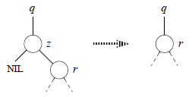
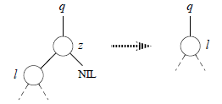
TREE-DELETE(T,z) (1/2)
from Edition 3
Case 1: z has no left child (ignore z’s right child)
➔ replace z by its right child
TRANSPLANT(T, z, z.right)
Case 2: z has 1 left child, no right child
➔ replace z by its left child
TRANSPLANT(T, z, z.left)
Case 3: z has 2 children, y = z.successor
y must be in z.right subtree & no left child
i.e., y = TREE-MINIMUM(z.right)
Case 1 & 2 are for z having 0 or 1 child

Slide 15
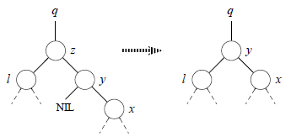
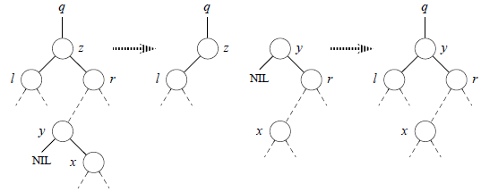
TREE-DELETE(T,z) (2/2)
from Edition 3
To replace z by y, splicing y out of its location
Case 3.1: y=z.right
TRANSPLANT(T, z, y)
set y.left = z.left (i.e., l)
set y.left.p (i.e., l.p) = y
Case 3.2: y in the z’s right subtree but not z.right
TRANSPLANT(T, y, y.right)
set y.right = z.right (i.e., r)
set y.right.p (i.e., r.p) = y
TRANSPLANT(T, z, y)
set y.left = z.left (i.e., l)
set y.left.p (i.e., l.p)= y

Slide 16
TREE-DELETE(T,z) (2/2)
from Edition 3
To replace z by y, splicing y out of its location, let l=z.left, r=z.right, x=y.right
Case 3.1: y = r
TRANSPLANT(T, z, y)
set y.left = l
set l.p = y
Case 3.2: y in the z’s right subtree but not z.right
TRANSPLANT(T, y, x)
set y.right = r
set r.p = y
TRANSPLANT(T, z, y)
set y.left = l
set l.p = y

Slide 17
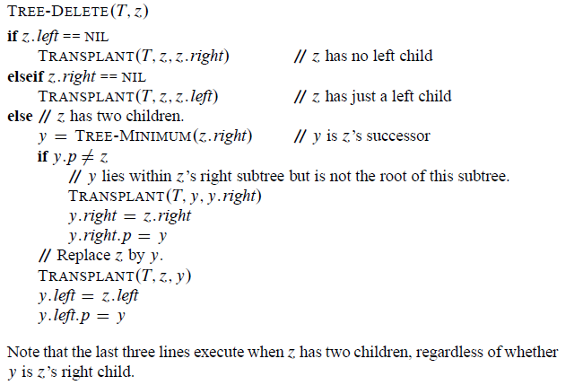
Pseudocode of TREE-DELETE(T,z)
from Edition 3
Case 1
Case 2
Case 3.2
Case 3.1
Time: O(h)

Slide 18
Randomly built Binary Search Trees
Given a set of n distinct keys. Insert them in random order into an initially empty binary search tree
Each of the n! permutations is equally likely
Different from assuming that every binary search tree on n keys is equally likely
the expected height of a randomly built binary search tree is O(lg n)

